Slide 1

Application for Bachelor’s Degree Course
Presenter
Dhananjay Pratap Lodhi

Slide 2
Introduction
This application consists of a use case for the students to create an application form for seeking the bachelor’s degree course in the ABC group of institutions.
Users/Students need some data to be used/referenced while creating the application form for bachelor’s degree course of their choice. So, this use case just focuses on creating these data types and instances to keep them ready to be referenced in the second use case that will be explained below after this use case.
Application Administrator/developer adds/updates/deletes the student, course data type instances (records) successfully in the data explorer.

Slide 3
Case Type
Only a single case type is needed : Student Application

Slide 4


Actors
Approver
User/Student

Slide 5
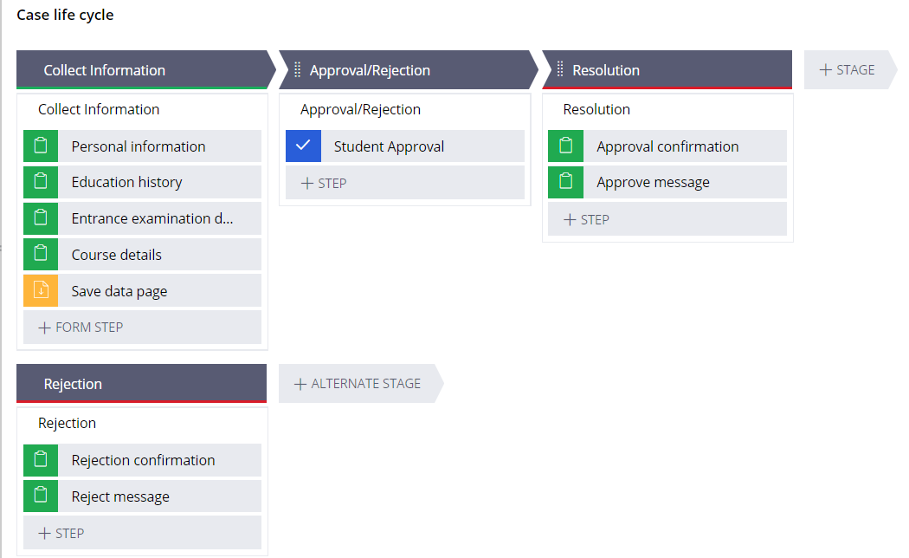
Case Stage Life Cycle

Slide 6
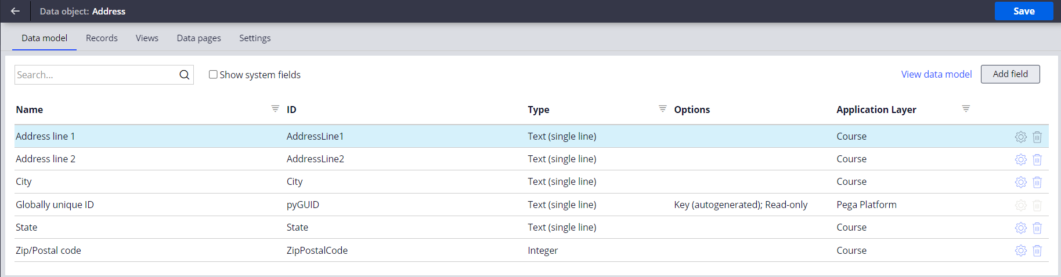
Address Data Type

Slide 7
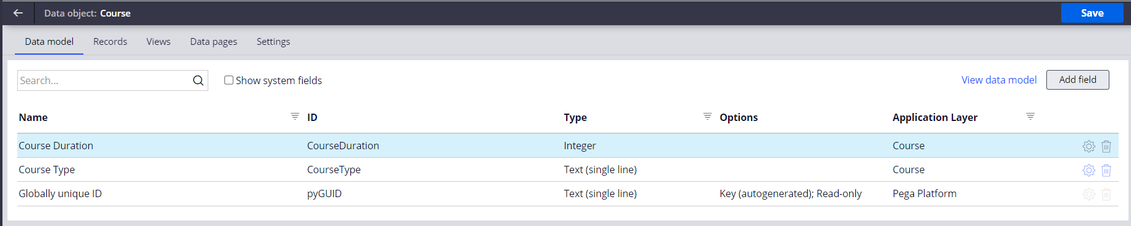
Course Data Type

Slide 8
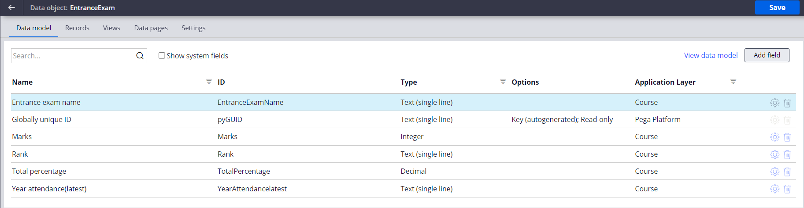
Entrance Exam Data Type

Slide 9
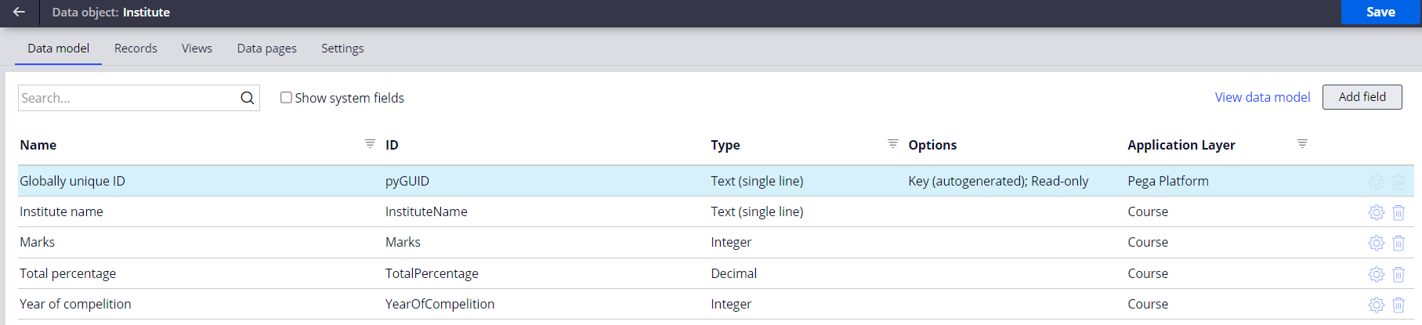
Institute Data Type

Slide 10
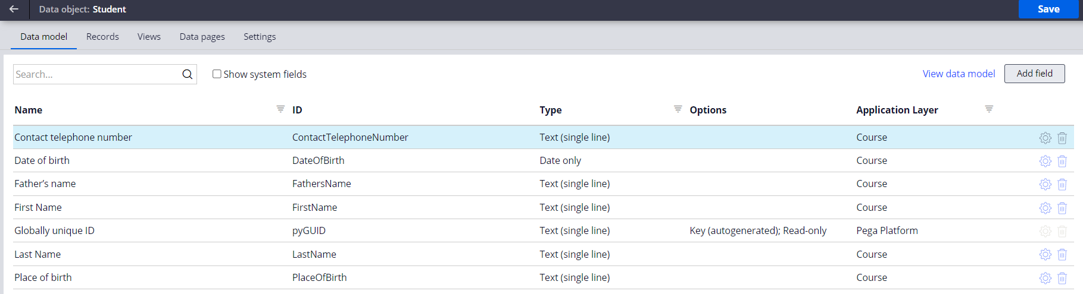
Student Data Type

Slide 11
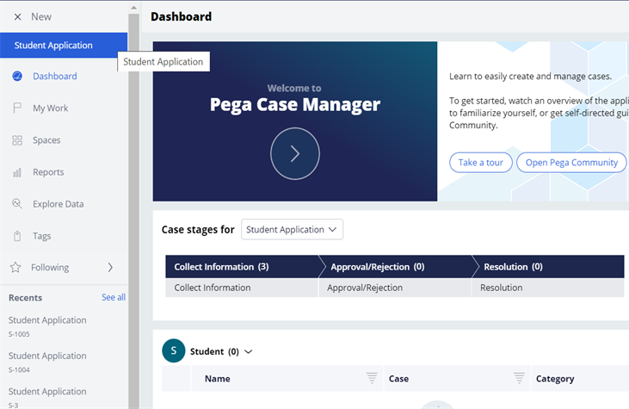
Student Portal
Student has option to create
STUDENT APPLICATION case
type.

Slide 12
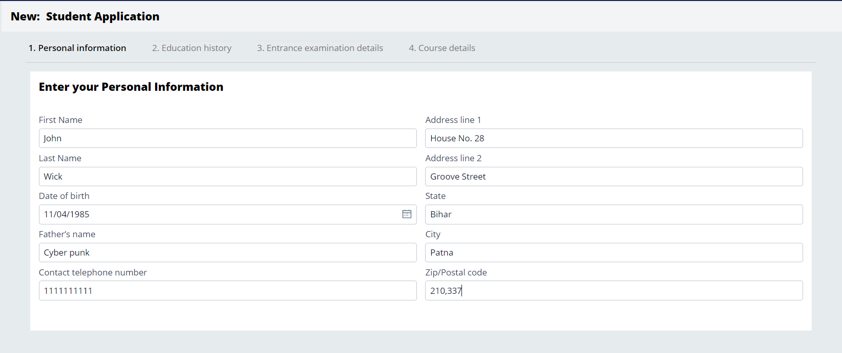
User Interface
Personal Information UI

Slide 13
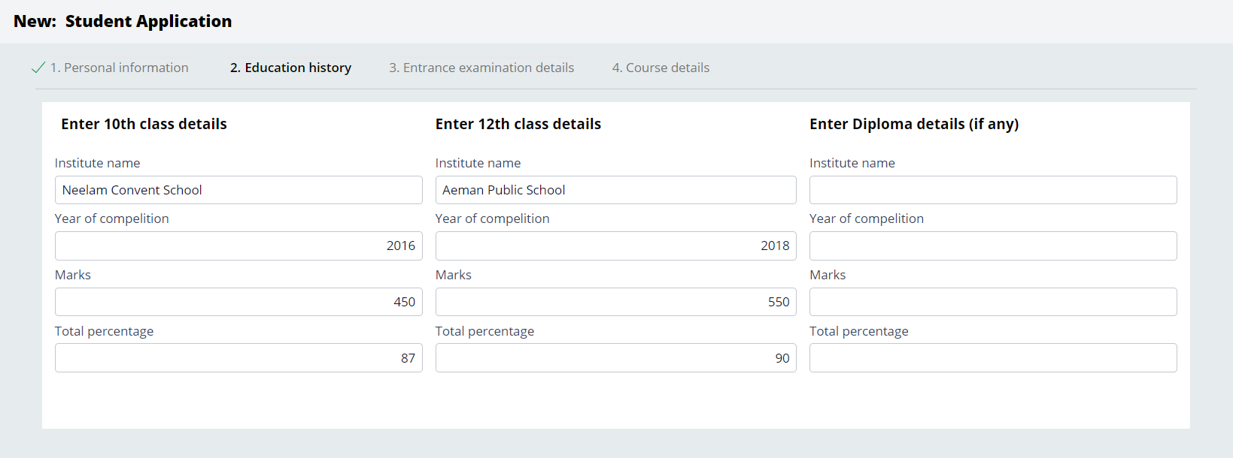
User Interface
Education history UI

Slide 14
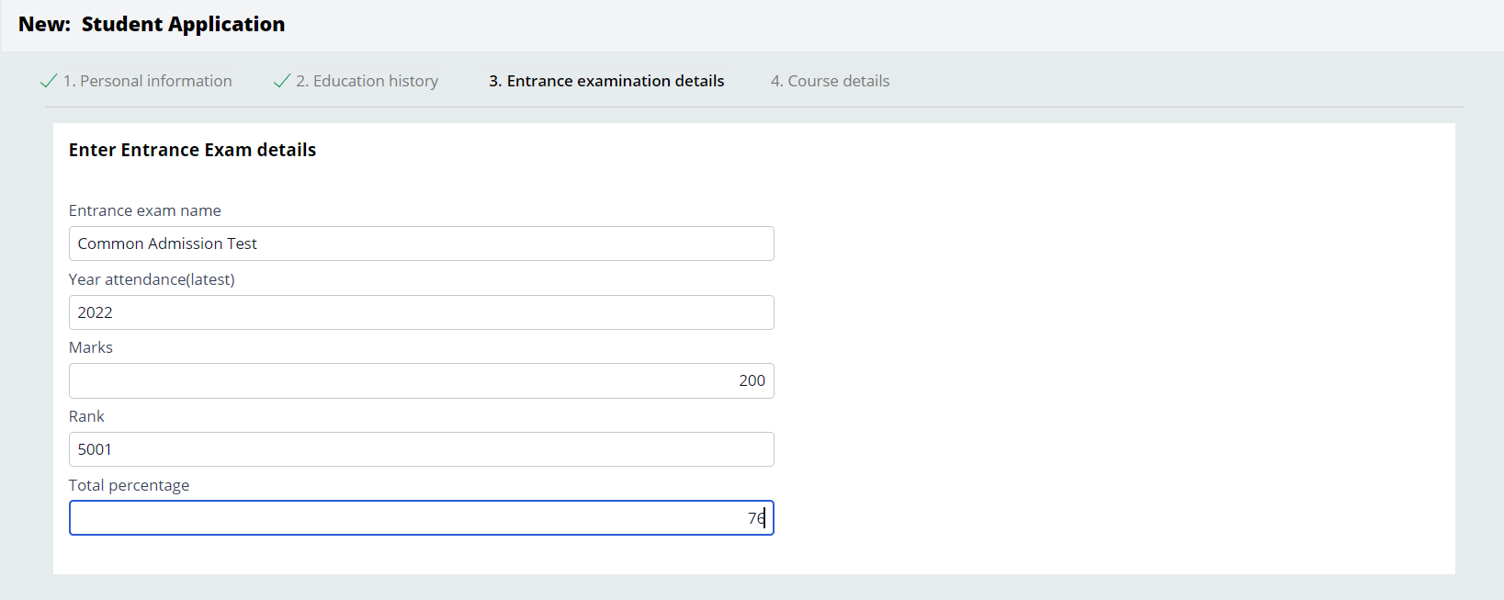
User Interface
Entrance Examination UI

Slide 15
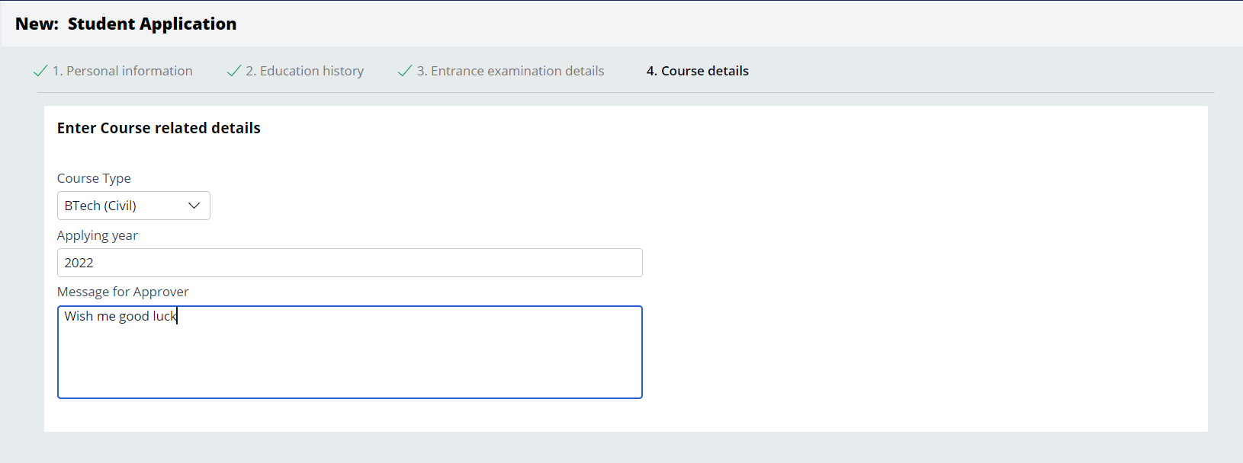
User Interface
Course details UI

Slide 16
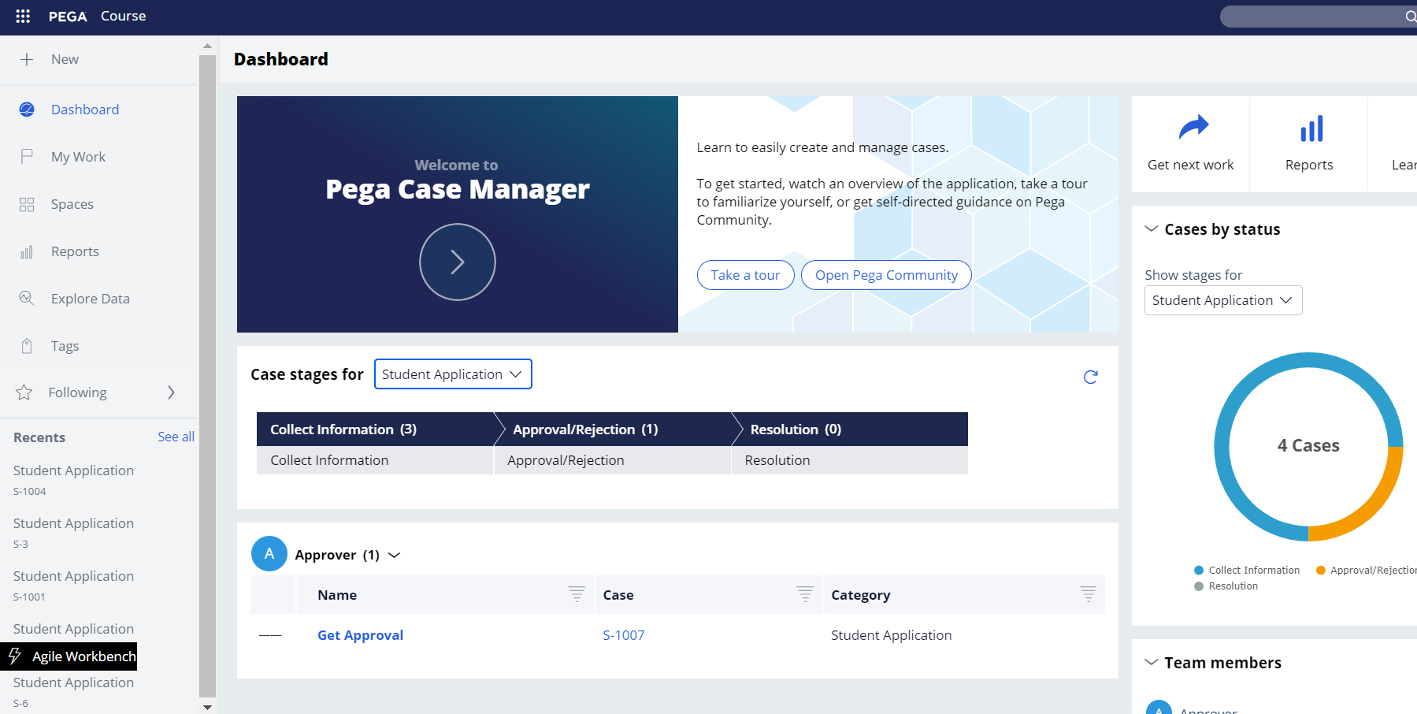
Approver Portal
Approver receive requests of STUDENT APPLICATION for approval/Rejection.

Slide 17
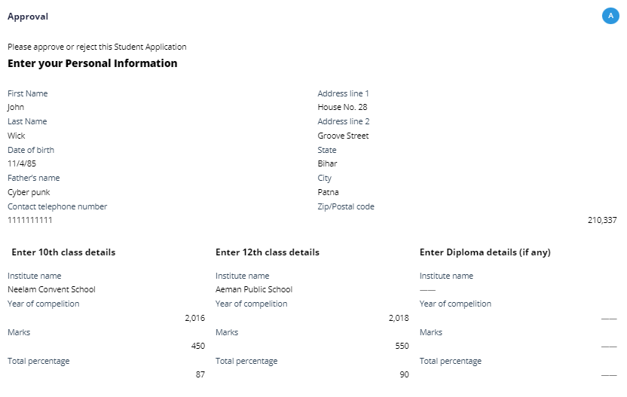
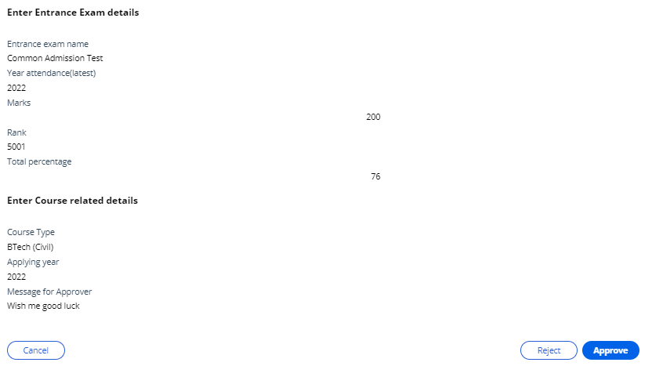
Approver Portal
All the information is available for approver to review, and decide whether to approve or reject the STUDENT APPLICATION

Slide 18
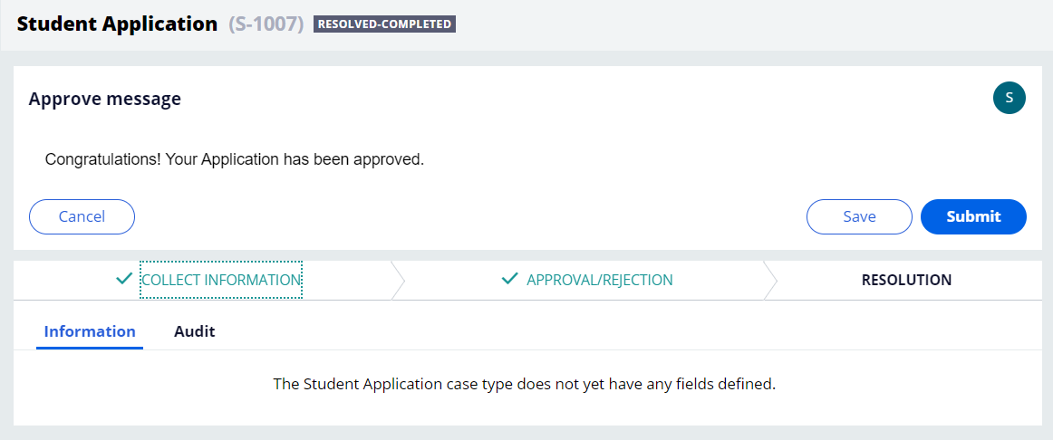
Application Approved
When student application is approved, a success message is routed to Student portal.

Slide 19
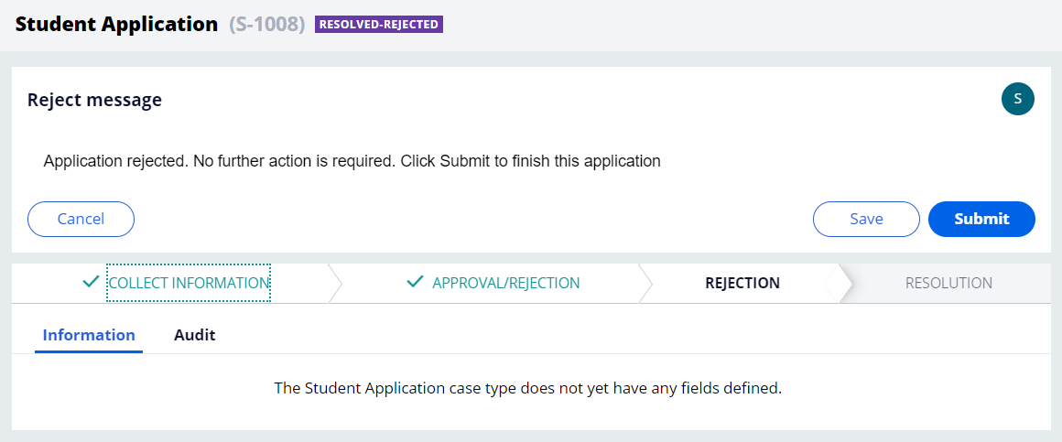
Application Rejected
When student application is rejected, a reject message is routed to Student portal.

Slide 20
Live Use Case Demo

Slide 21
Thank You
Presented by
Dhananjay Pratap Lodhi
dhananjay-pratap.lodhi@capgemini.com

